Slide 1
產製CB歷程報表

Slide 2
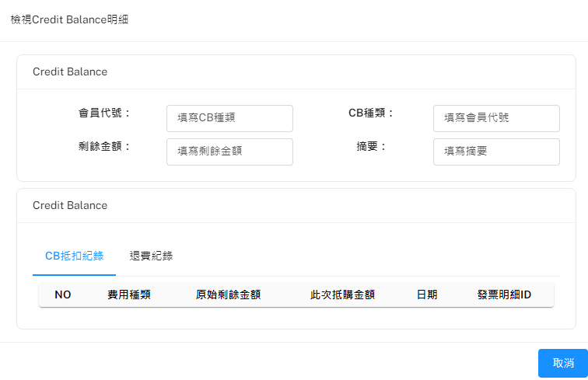
產製CB報表
Method: POST
URL: http://localhost:8000/api/v1/CreditBalanceStatement/generateReport
POST Body:
{
"CBID": 1,
"Download": true
}

